Slide 1
Art Computer Programming
Dr.U.S.N.Raju
Associate Professor,
Dept. of CSE, NIT Warangal

Slide 2
There is a old story about two men working on a railroad track many years back. As they are laying track in the heat of the day, a person drives by in a car and rolls down the window.
He yells, “Tom, is that you?” Tom, one of the men working on the track, replies, “Chris, it’s great to see you! It must have been 20 years…How are you?” They continue the conversation and Chris eventually drives off.
When he leaves, another worker turns to Tom and says, “I know that was the owner of the railroad and he’s worth nearly a billion dollars. How do you know him?”
Tom replies, “Chris and I started working on the railroad, laying track, on the same day 20 years ago. The only difference between Chris and me is that I came to work for $1.25/hour and he came to work for the railroad”

Slide 3
Perspective (=viewpoint)
Aspiration (=target)
Ambition (=desire)
These are the attributes that separate those who come to work for a paycheck versus those who come to work to change the world.

Slide 4
Fundamentals of Computing and Computer.
C/C++/Python Programming Language: Basics and Control Statements, Arrays,….

Slide 5
Fundamentals of Computing and Computer

Slide 6
Fundamental of Computing and Computer
18th Century- Industrial Revolution
19th Century-Steam Engine
20th Century-Telephone Network
21st Century-Computer
22nd Century- ????
23rd Century-????

Slide 7
What is a Computer
Characteristics of Computer
History of Computer
Generations of Computer
Classification of Computers (micro, mini, Mainframe, Super)
Computer System (Hardware and Software)
Computer Hardware
Computer Software
7. Application of Computers

Slide 8
1. What is a Computer
Computer is an electronic device that accepts data as input, processes the input data by performing mathematical and logical operations on it, and gives the desired output.
Two categories
Digital Computer
Analog Computer

Slide 9
Digital Computer uses the digits 0s and 1s to represent the data. The computers that we use at our homes and offices are digital computers.
Analog Computer represent the data as variable across a continuous range of values. The earliest computers were analog computers. Analog computers are used for measuring the parameters that vary continuously in real time, such as temperature, pressure and voltage. Analog computers are more flexible and less precise than digital computers.

Slide 10
2. Characteristics of Computer
Speed
Accuracy
Diligence
Storage capability
Versatility

Slide 11
Speed: The computer can process data very fast, at the rate of millions of instructions per second.
Accuracy: Computers provide high degree of accuracy. For example, the computer can accurately give the result of division of any two numbers up to 10 decimal places.
Diligence: When used for longer period of time, the computer does not get tired (like humans). It can perform long and complex calculations with the same speed and accuracy from the start till the end.
Storage Capability: Large volumes of data and information can be stored in the computer and also retrieved whenever required.
Versatility: Computer is versatile in nature. It can perform different types of tasks with the same ease. At one moment you can use the computer to prepare a letter document and in the next moment you play music or print a document.

Slide 12
3. History of Computer
Until the development of the first computer, there had been several developments in the computing technology related to the mechanical computing devices. The key developments that took place till the first computer was developed are:
Calculating machines – ABACUS
Napier’s Bone
Slide Rule
Pascal’s Adding and Subtraction Machine
Leibniz’s Multiplication and Dividing Machine
Punch card system
Babbage’s Analytical Engine
Hollerith’s punched card tabulating machine
The developments discussed above resulted in the development of first computer in the 1940s.

Slide 13
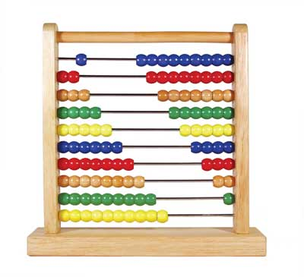
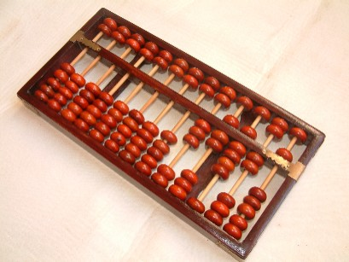
ABACUS

Slide 14
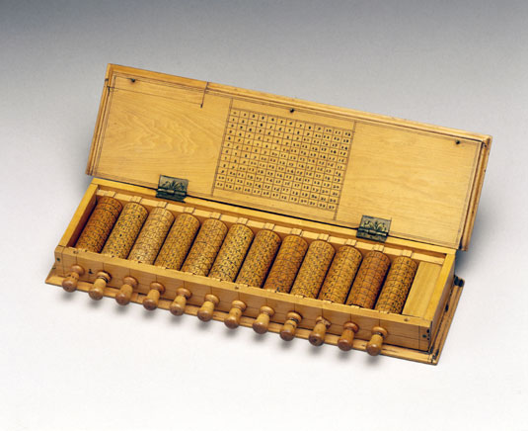
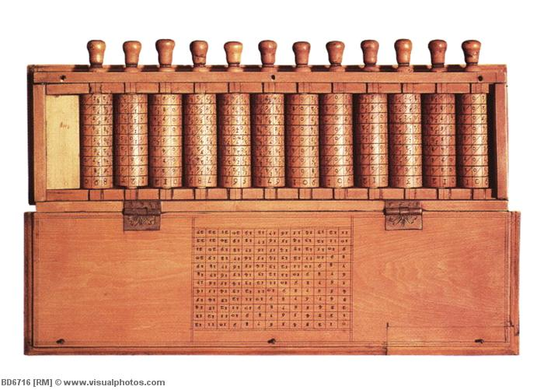
Napier’s Bone

Slide 15
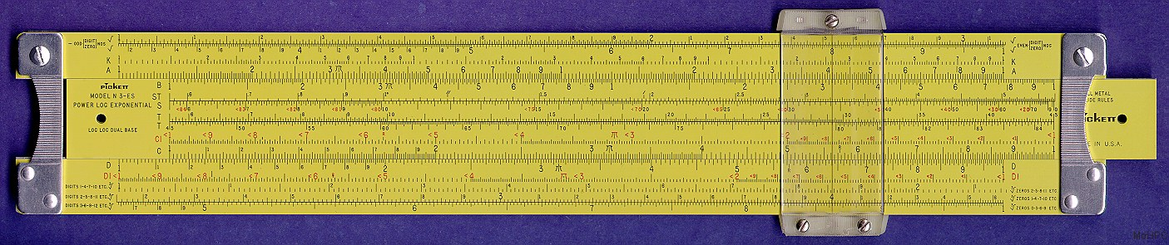
Slide Rule

Slide 16
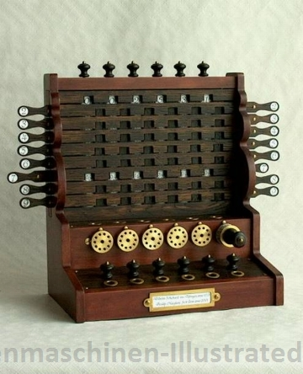
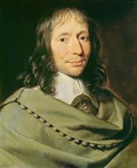
Pascal 1623-1662
Pascal’s Adding and Subtraction Machines

Slide 17
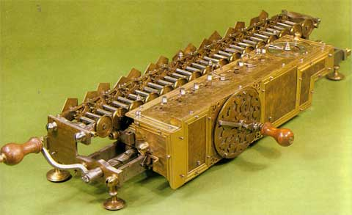
Leibniz’s Multiplication and Dividing Machine

Slide 18
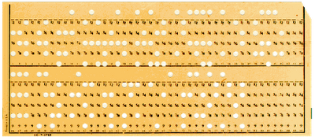
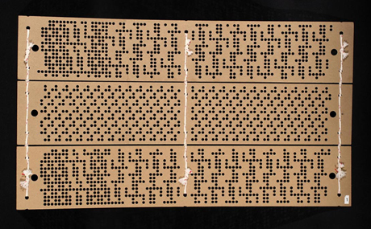
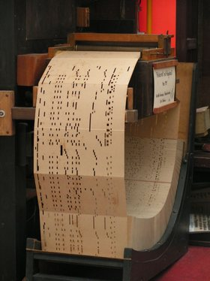
Punch Card System

Slide 19
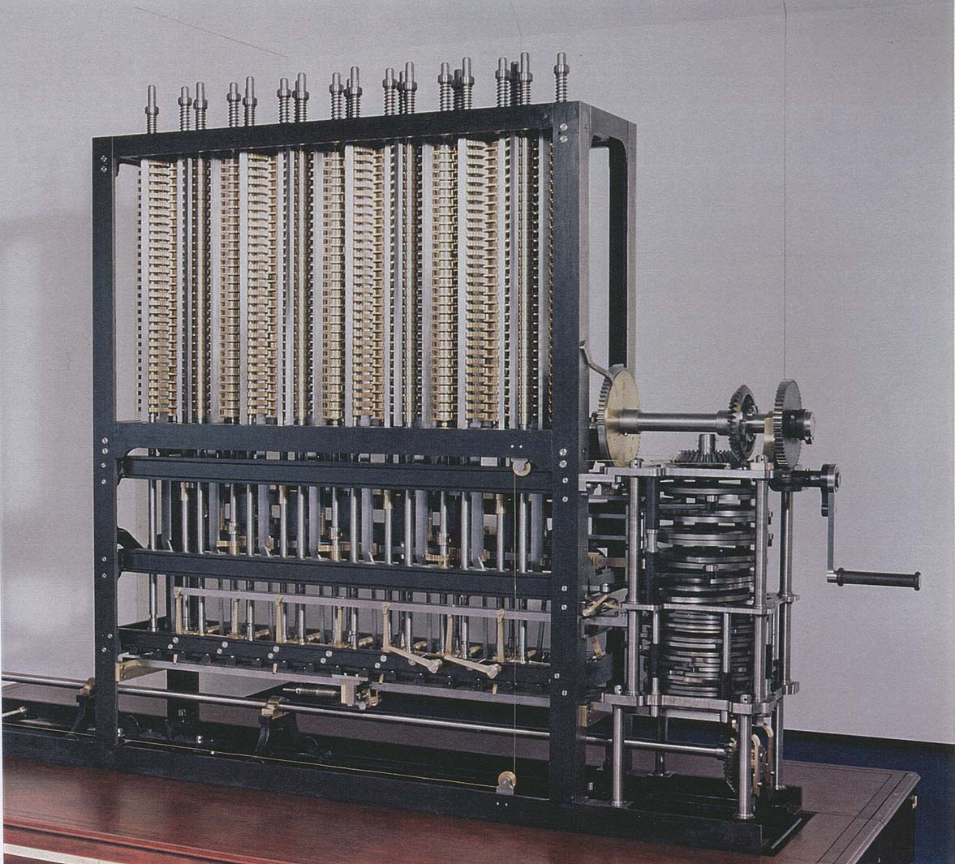

Babbage’s Analytical Machine

Slide 20
4. Generations of Computer
Five generations
Categorized on the basis of
Technology used by them (hardware and software)
Computing characteristics (speed - number of instructions executed per second)
Physical appearance
Their applications

Slide 21
Generations of Computers
First
Second
1956-63
1940-56
Vacuum Tubes
Fifth
Third
Transistors
1964-71
Integrated Circuits
Fourth
1971-Present
Microprocessors
Present and Next
Artificial Intelligence

Slide 22
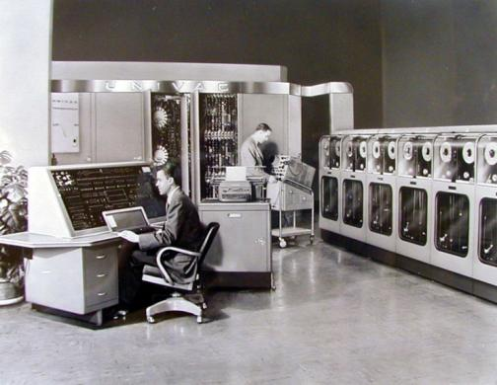
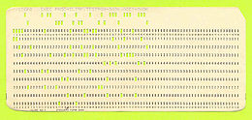
First Generation: 1940-56
Vacuum tubes, magnetic drums, punched cards, paper tapes and printouts
Machine language
Computation time in milliseconds
Enormous in size
For scientific applications
Examples
UNIVersal Automatic Computer (UNIVAC)
Electronic Numerical Integrator And Calculator (ENIAC)
Electronic Discrete Variable Automatic Computer (EDVAC)
UNIVAC
Punched Card

Slide 23
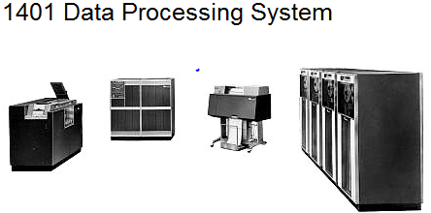
Second Generation: 1956-1963
Transistors, magnetic core technology , magnetic tapes and magnetic disks, concept of a stored program
Assembly language
Computation time in microseconds.
Reduced size compared to first generation computers
Cost of commercial production was very high
Examples
PDP-8
IBM 1401
CDC 1604

Slide 24
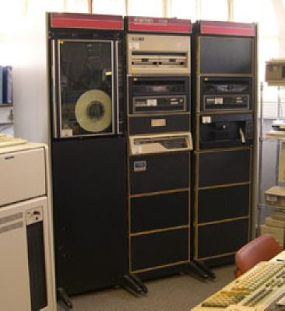
Third Generation: 1964-1971
Integrated Circuit (IC) chips, keyboard, Monitor
Operating system, High-level languages
Computation time in nanoseconds
Quite small compared to second generation computers
Accessible to mass audience
Produced commercially
Examples
IBM 370
PDP 11
DEC PDP 11

Slide 25
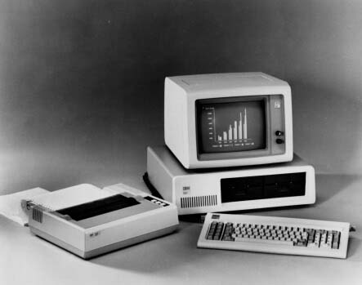
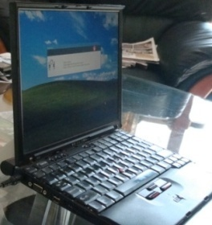
Fourth Generation: 1971-Present
LSI, VLSI, Microprocessor, PC, Semiconductor Memory, Linking of computers, Mouse and Handheld Devices
GUI, OS like MS-DOS and MS-Windows
High-Level Programming Languages
Computation time in picoseconds
Smaller than computers of previous generation
Widely available for commercial purposes
PC for home user
Examples
Intel 4004 chip was the first Microprocessor
IBM, Apple’s Macintosh

Slide 26
Fifth Generation: Present & Next
Using Artificial Intelligence (AI)
Expert Systems (ES), NLP, Speech recognition, Voice recognition, Robotics etc.
Capable of learning and self organization
SLSI, large memory
Parallel processing

Slide 27
5. Classification of Computers
Categories based on
Size
Type
Categories
Microcomputers
Minicomputers
Mainframe computers
Supercomputer

Slide 28
Microcomputer
Small, low-cost, single-user digital computer.
Include
Desktop computer or PC: Stand-alone machine, not very expensive, for single user.
Manufacturers: Apple, Microsoft, HP, Dell, Lenovo, …
Notebook or laptop: Portable , small size, costlier than desktop
Netbook: Smaller notebooks, low weight, low cost, for web-based applications.
Tablet computer: Input via stylus or pen, Portable
Handheld computer or PDA: Held on top of palm, small in size, uses pen or stylus, limited memory, less powerful.
Smart phones: Cellular phones (function both as phone and small PC), to access e-mail, download music, play games etc.
Manufacturers: Blackberry, Apple, HTC, Nokia, LG, Motorola

Slide 29

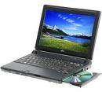
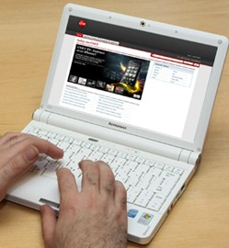
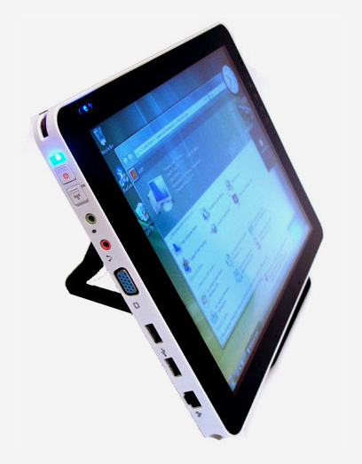
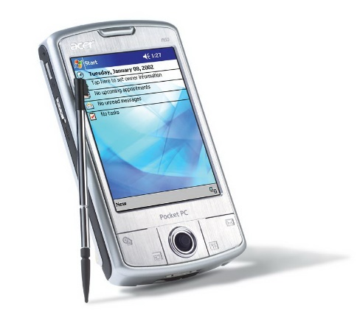
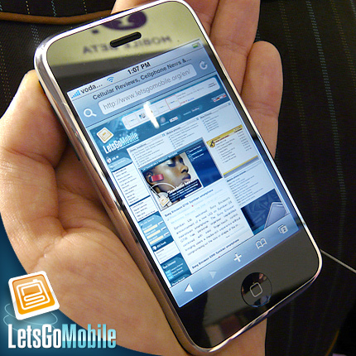
Desktop
Laptop or Notebook
Netbook (not the notebook)
Palmtop
Tablet
Smart phone

Slide 30
Minicomputers
Multi-user systems.
High processing speed
High storage capacity than the microcomputers.
Support 4 to 200 users simultaneously.
Examples
PDP 11
IBM (8000 series)

Slide 31
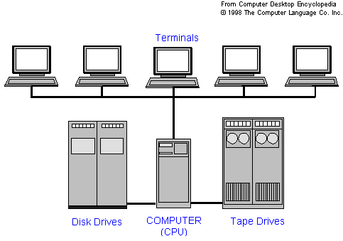
Minicomputer

Slide 32
Mainframe computers
Multi-user, multi-programming , high-performance computers.
Very high speed, large storage capacity
Used in centralized databases.
Access via dumb terminal, an intelligent terminal, or PC.
Dumb terminal: No own data storage & processing. Has I/O device only.
Intelligent terminal: Has the I/O device, can do processing, but, cannot store data of its own.
Use processing power and storage facility of mainframes
Examples
CDC 6600
IBM ES000 series.

Slide 33
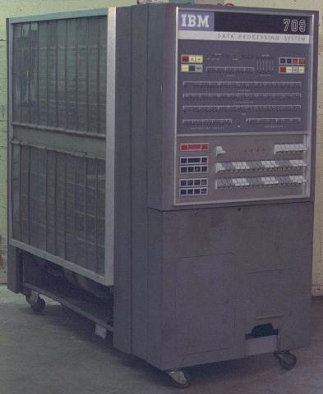
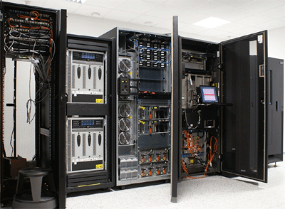
Mainframe Computer

Slide 34
Supercomputers
Fastest and the most expensive machines.
High processing speed
Speed in FLOPS (FLoating point Operations Per Second).
Used for highly calculation-intensive tasks - weather forecasting, climate research, molecular research, biological research, nuclear research
Examples
IBM Roadrunner, IBM Blue gene
Intel ASCI red.
PARAM in India

Slide 35
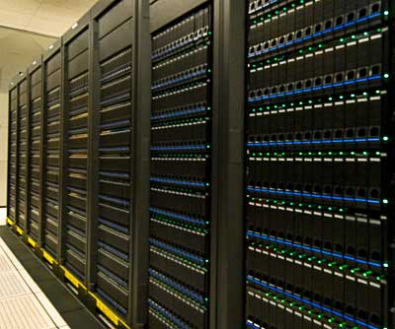
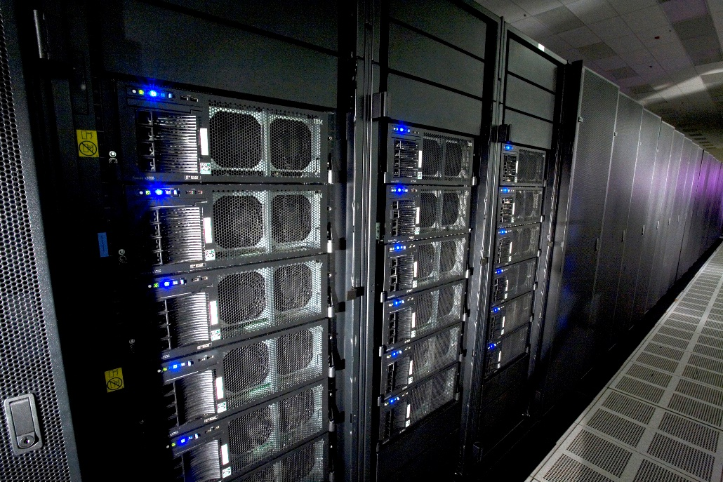
Super Computer

Slide 36
6. Computer System
Four parts
Hardware: Mechanical parts of computer, e.g. Keyboard, monitor, hard disk drive etc.
Software: Set of instructions (Program) and documentation. Instructs the computer about the task to be performed.
Data - Isolated values or raw facts.
Provided as input to computer for processing
Users -People who write computer programs or interact with computer.

Slide 37
Components of Computer Hardware
Memory Unit
CPU
Registers
Input Unit
Output Unit
Control Unit
Arithmetic and Logic Unit

Slide 38
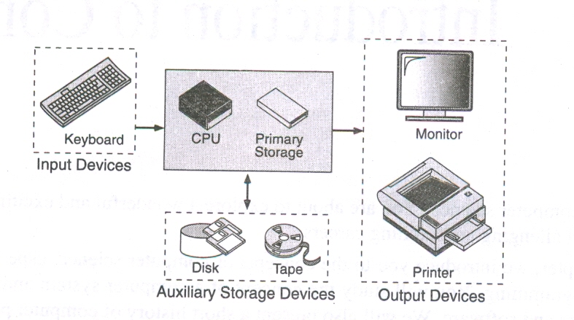

Slide 39
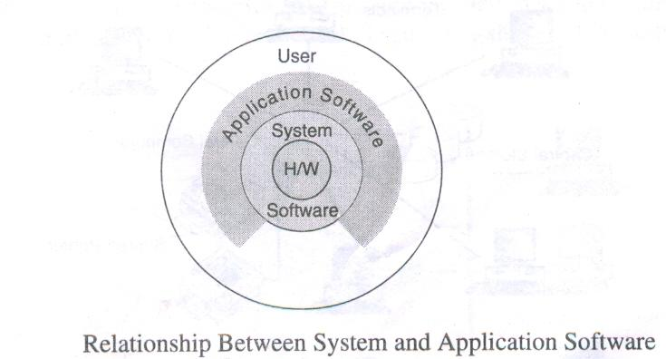

Slide 41
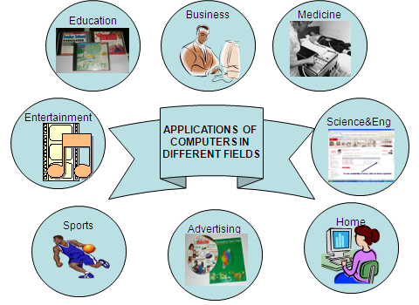
7. Application of Computers

Slide 42
How to make use of the computer for us

Slide 44
C/C++/Python Programming Language: Basics and Control Statements, Arrays,….

Slide 45
Thank you

